Slide 1




Large-Scale Indoor Localization
via Outdoor Crowdsourcing Trajectories
on Ride-Hailing Platform
Shuli Zhu^{*1}, Lingkun Li^{*1}, Xuyu Wang², Qiang Ni³,
Yuqin Jiang⁴, Hui Gao⁴, Zhaobing Han⁴, Ruipeng Gao^{☨1}
☨Corresponding author
Notes:
Thanks for the introduction. Good afternoon everyone. I am Shuli Zhu from Beijing Jiaotong University. Today I am giving a talk of our paper titled Large-Scale Indoor Localization via Outdoor Crowdsourcing Trajectories on Ride-Hailing Platform

Slide 2
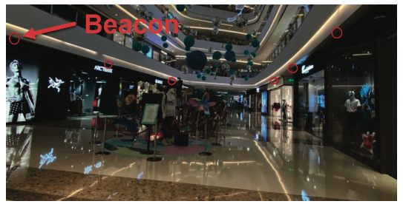
Motivation
Limitations of existing industrial fingerprint-based approaches for large-scale indoor positioning
  High deployment costs
    Requiring “site surveys” or deploying special hardware[1]
[1] Experience: Practical indoor localization for malls
Notes:
Indoor positioning is a fundamental technology for Location-Based Services (LBS), especially when users request orders on ride-hailing platforms.
In recent years, researchers have proposed numerous industrial fingerprint-based approaches for large-scale indoor positioning.
However, these approaches have the following limitations:
First, high deployment costs! On-site surveys or deployment of additional hardware devices are required. As shown in the figure, researchers deploy Beacons in a shopping mall to locate users. Such methods are time-consuming, labor-intensive, and costly.
室内定位是基于位置服务的一项基础技术，特别是在网约车平台用户发单时。近年来，研究人员基于指纹定位提出了众多大规应用的工业级方法。但这些方法尚且存在如下局限。
第一，高部署成本！需要现场勘测或部署额外的硬件设备。如左图，开发者在商场部署了Beacon以定位用户。这类方法耗时、费力且成本高昂。
第二，指纹稳定性差！如右图，我们统计了一年内三座不同城市的商场内指纹变化，结果表明一年后只保留了70%～80%的指纹。因此，为保证稳定性，开发者需定期现场勘测以更新指纹，这会带来高昂成本。
第三，可访问性受限！开发者利用AP名匹配PoI以确定其位置，并基于此实现定位。但基于网约车平台的众包数据，我们发现部分商场PoI信息缺失，且有19.8%的AP无法获取其名称（Wi-Fi SSID），这会导致该类方法精度严重下降。

Slide 3
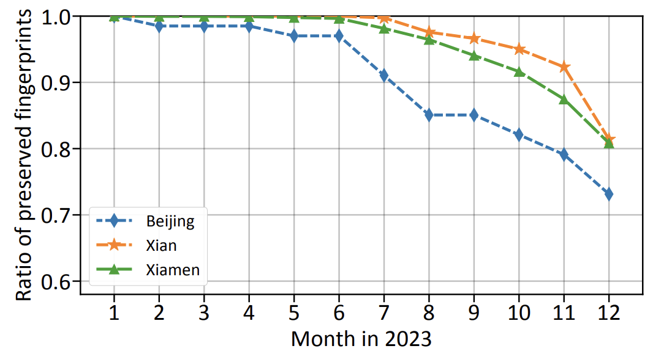
Motivation
Limitations of existing industrial fingerprint-based approaches for large-scale indoor positioning
  High deployment costs
    Requiring “site surveys” or deploying special hardware[1]
  Temporal instability
[1] Experience: Practical indoor localization for malls
Notes:
Second, temporal instability! As shown in the figure, we analyzed the fingerprint changes in three different shopping malls over one year. The results indicate that only 70%--80% of preserved fingerprints remain valid after one year. Therefore, to ensure stability, researchers have to conduct regular on-site surveys to update fingerprints, which incurs significant costs.
室内定位是基于位置服务的一项基础技术，特别是在网约车平台用户发单时。近年来，研究人员基于指纹定位提出了众多大规应用的工业级方法。但这些方法尚且存在如下局限。
第一，高部署成本！需要现场勘测或部署额外的硬件设备。如左图，开发者在商场部署了Beacon以定位用户。这类方法耗时、费力且成本高昂。
第二，指纹稳定性差！如右图，我们统计了一年内三座不同城市的商场内指纹变化，结果表明一年后只保留了70%～80%的指纹。因此，为保证稳定性，开发者需定期现场勘测以更新指纹，这会带来高昂成本。
第三，可访问性受限！开发者利用AP名匹配PoI以确定其位置，并基于此实现定位。但基于网约车平台的众包数据，我们发现部分商场PoI信息缺失，且有19.8%的AP无法获取其名称（Wi-Fi SSID），这会导致该类方法精度严重下降。

Slide 4
Motivation
Limitations of existing industrial fingerprint-based approaches for large-scale indoor positioning
  High deployment costs
    Requiring “site surveys” or deploying special hardware[1]
  Temporal instability
  Limited accessibility
    Estimating AP locations through name matching with PoIs (Point of Interest)[2]
      Lack of PoI information
      19.8% scanned APs with blank SSID
[1] Experience: Practical indoor localization for malls
[2] Experience: Pushing indoor localization from laboratory to the wild
Notes:
Third, limited accessibility! Developers match Access Point (AP) names with Points of Interest (PoI) to determine their locations for positioning. However, using crowdsourced data from ride-hailing platforms, we found that PoI information is missing in some shopping malls, and the names (Wi-Fi SSIDs) of 19.8% of APs cannot be obtained—this severely degrades the positioning accuracy of such methods.
室内定位是基于位置服务的一项基础技术，特别是在网约车平台用户发单时。近年来，研究人员基于指纹定位提出了众多大规应用的工业级方法。但这些方法尚且存在如下局限。
第一，高部署成本！需要现场勘测或部署额外的硬件设备。如左图，开发者在商场部署了Beacon以定位用户。这类方法耗时、费力且成本高昂。
第二，指纹稳定性差！如右图，我们统计了一年内三座不同城市的商场内指纹变化，结果表明一年后只保留了70%～80%的指纹。因此，为保证稳定性，开发者需定期现场勘测以更新指纹，这会带来高昂成本。
第三，可访问性受限！开发者利用AP名匹配PoI以确定其位置，并基于此实现定位。但基于网约车平台的众包数据，我们发现部分商场PoI信息缺失，且有19.8%的AP无法获取其名称（Wi-Fi SSID），这会导致该类方法精度严重下降。

Slide 5
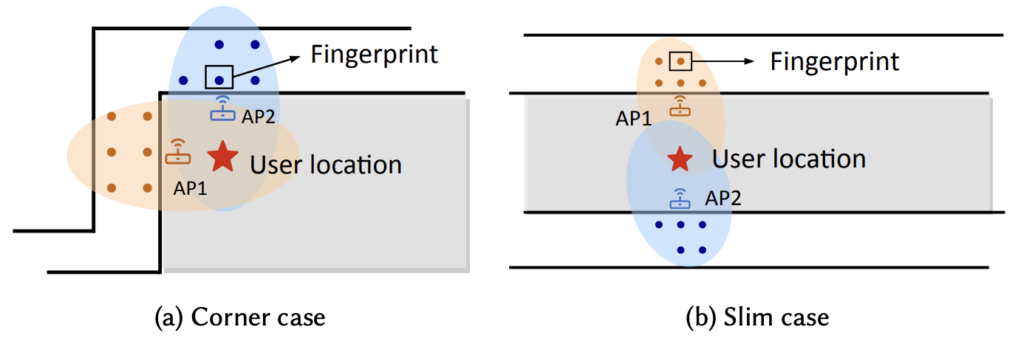
Using outdoor fingerprints to locate indoor users
Our finding: Possibility of Indoor Positioning Using Fingerprints Collected Outdoors
  Corner case & slim case
Notes:
To address the limitations of existing positioning approaches, we propose a new scheme that enables outdoor-collected fingerprints to locate indoor users.
The inspiration for this method stems from two key observations we made. As illustrated in the figure, the building (shaded in gray) is surrounded by roads, where devices on the roads can collect fingerprints of indoor APs. Specifically, in the left figure, the orange and blue dots represent the fingerprints of AP1 and AP1, respectively. If users are at the location marked by the red asterisk, they can detect signals from both AP1 and AP2. By leveraging the positions of fingerprints collected at the orange and blue dots, the users’ locations can be estimated. The right figure depicts a similar scenario.
为了克服目前定位方法存在的诸多局限，我们提出了适用室外指纹定位室内用户的方法。
该方法的灵感来源于我们的两点发现。如图所示，建筑物（灰色阴影）被道路环绕，道路上的设备可以采集室内AP指纹。如左图，橙色点表示AP1的指纹，蓝色点表示AP2的指纹。如果用户位于标记为红色星号的位置，则可以检测到来自AP1和AP2的信号,通过利用在橙色点和蓝色点处采集的指纹位置，可以估计用户的室内位置。右图类似情况。
因此，我们设计了一种基于Wi-Fi指纹的新型众包室内定位系统。指纹采集者无需进入建筑物内部，直接从建筑物外围采集Wi-Fi信号并构建指纹集，可以利用这一指纹集实现室内定位。
我们的方法解决了以往系统的局限性，且具备如下优势：开发与维护成本低（无需现场勘测、部署硬件设备等）、能够防止指纹失效（众包更新指纹）、极大的便捷性。

Slide 6
Using outdoor fingerprints to locate indoor users
Our finding: Possibility of Indoor Positioning Using Fingerprints Collected Outdoors
  Corner case & slim case
Propose a new crowdsourced Wi-Fi fingerprint-based indoor positioning system
  Low development and maintenance costs
  Prevent fingerprint set from becoming outdated
  Unmatched accessibility
Notes:
Based on these observations, we have designed a novel crowdsourced Wi-Fi fingerprint-based indoor positioning system.
Researchers do not need to enter the building; instead, they can directly collect outdoor Wi-Fi signals around the buildings to construct a fingerprint database. This database can be used for indoor positioning.
Our method overcomes the limitations of previous systems and offers the following advantages:
1) Low development and maintenance costs.
2) Prevent fingerprint set from becoming outdated.
3) Unmatched accessibility.
为了克服目前定位方法存在的诸多局限，我们提出了适用室外指纹定位室内用户的方法。
该方法的灵感来源于我们的两点发现。如图所示，建筑物（灰色阴影）被道路环绕，道路上的设备可以采集室内AP指纹。如左图，橙色点表示AP1的指纹，蓝色点表示AP2的指纹。如果用户位于标记为红色星号的位置，则可以检测到来自AP1和AP2的信号,通过利用在橙色点和蓝色点处采集的指纹位置，可以估计用户的室内位置。右图类似情况。
因此，我们设计了一种基于Wi-Fi指纹的新型众包室内定位系统。指纹采集者无需进入建筑物内部，直接从建筑物外围采集Wi-Fi信号并构建指纹集，可以利用这一指纹集实现室内定位。
我们的方法解决了以往系统的局限性，且具备如下优势：开发与维护成本低（无需现场勘测、部署硬件设备等）、能够防止指纹失效（众包更新指纹）、极大的便捷性。

Slide 7
Challenges
Challenge 1
  Dealing with abnormal APs that produce unreliable fingerprints
Challenge 2
  Handling the existence of “black holes” where no fingerprints are available
Challenge 3
  Using outdoor fingerprints to estimate indoor positions
Notes:
To achieve such a convenient positioning system is not easy. During the actual deployment process, we encounter three major challenges.
Challenge 1, dealing with abnormal APs that produce unreliable fingerprints.
Challenge 2, handling the existence of “black holes” where no fingerprints are available.
Challenge 3, using outdoor fingerprints to estimate indoor positions.
要实现如此便捷的定位系统绝非易事，在实际部署过程中，我们面临三大挑战。
挑战一，处理异常AP引起的不可靠指纹。挑战二，解决无指纹区域方法不可用的问题。挑战三，使用室外指纹估算室内位置。

Slide 8
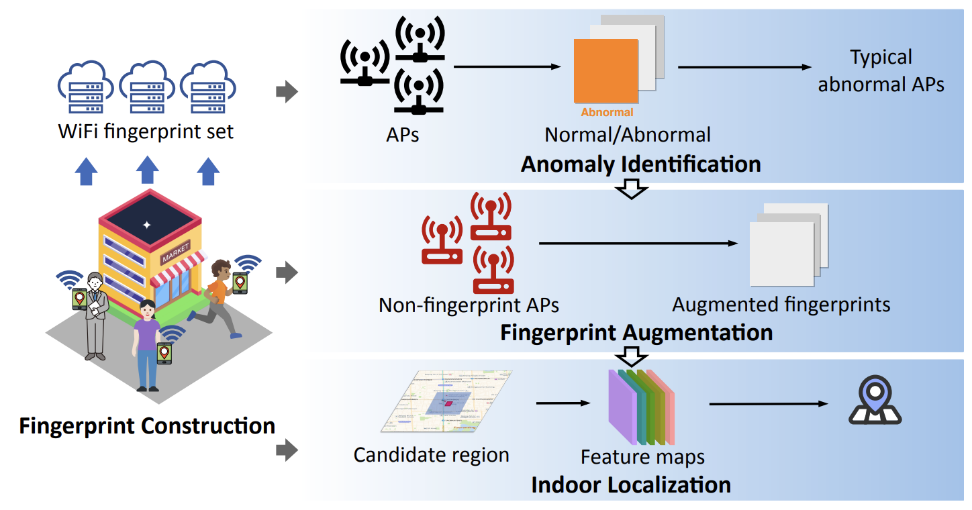
System Overview
Fingerprint Construction
Anomaly Identification (challenge 1)
Fingerprint Augmentation (challenge 2)
Indoor Localization (challenge 3)
Notes:
Our system overview design is shown in the figure, including fingerprint construction, anomaly identification, fingerprint augmentation, and indoor localization.
我们的系统整体设计如图所示，包含四大模块：指纹库构建、异常识别、指纹增强与室内定位。
（异常识别解决挑战一；指纹增强解决挑战二；室内定位解决挑战三。）

Slide 9
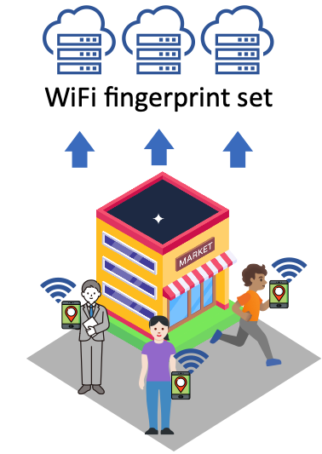

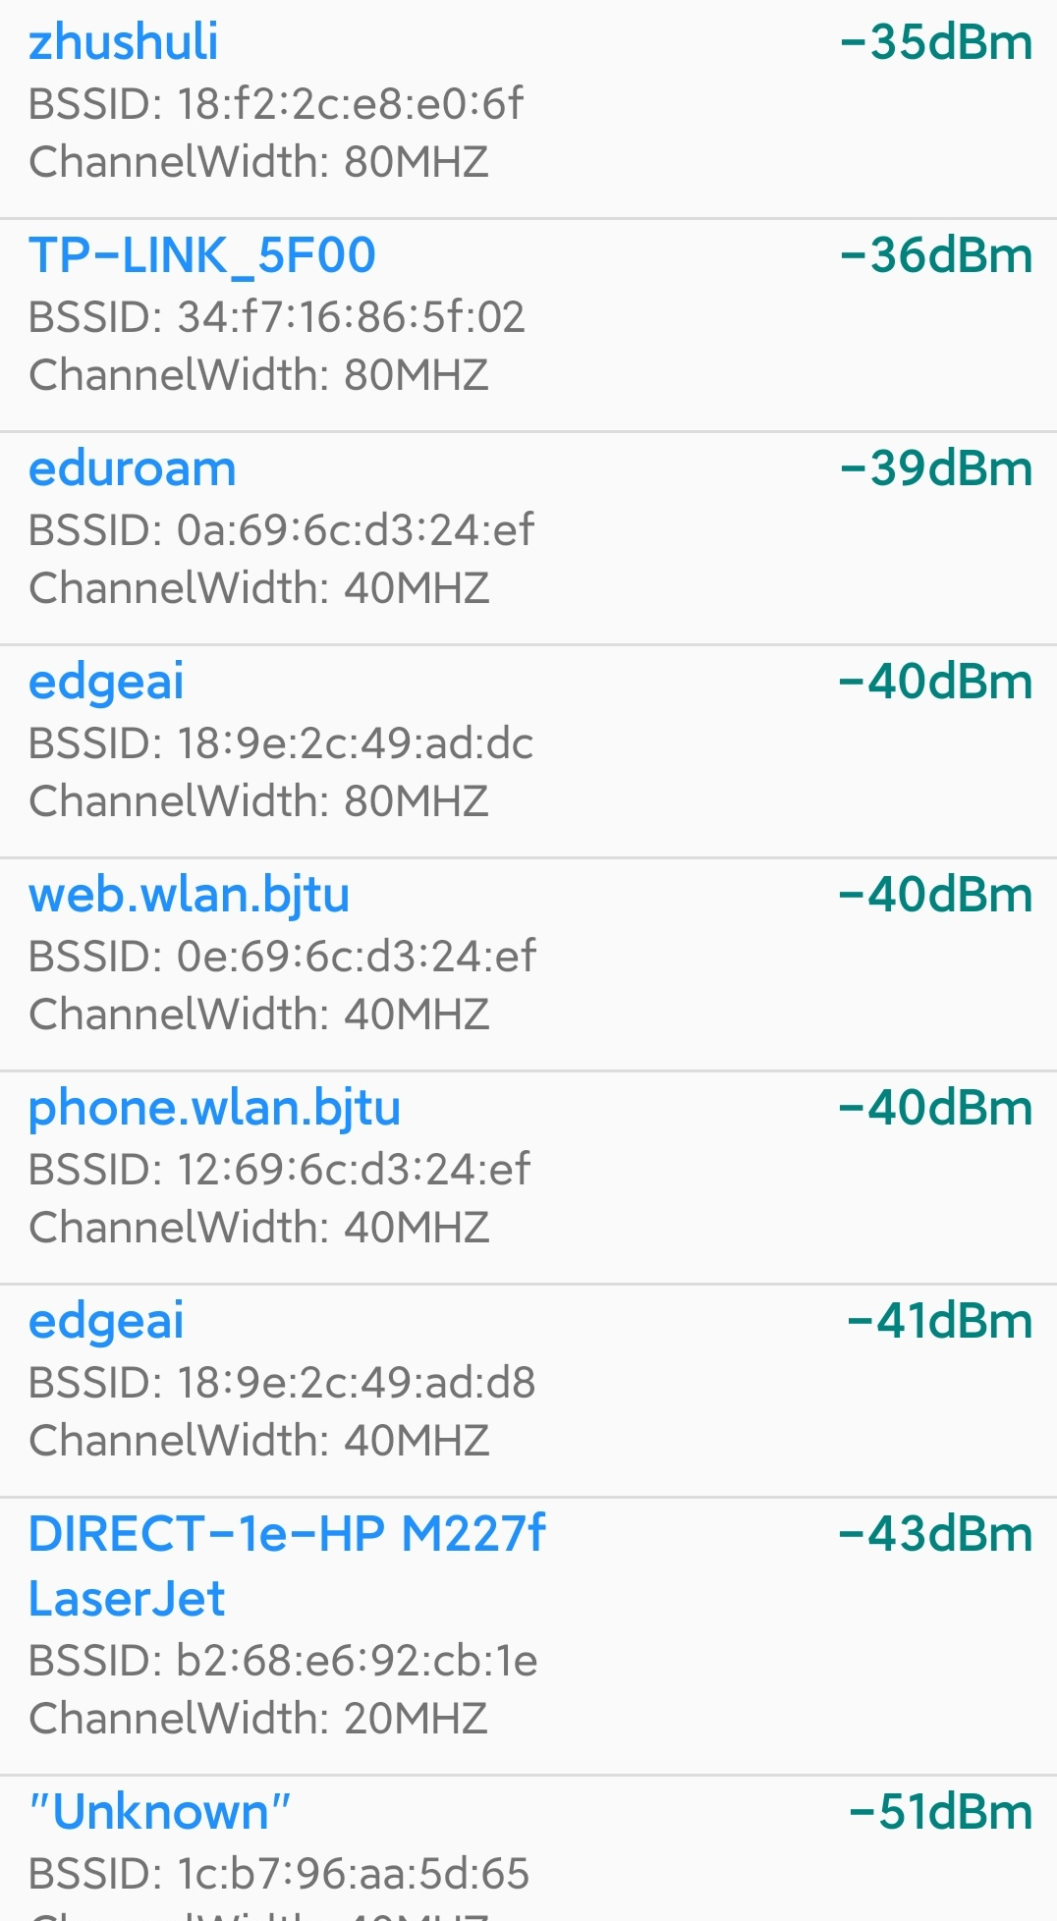
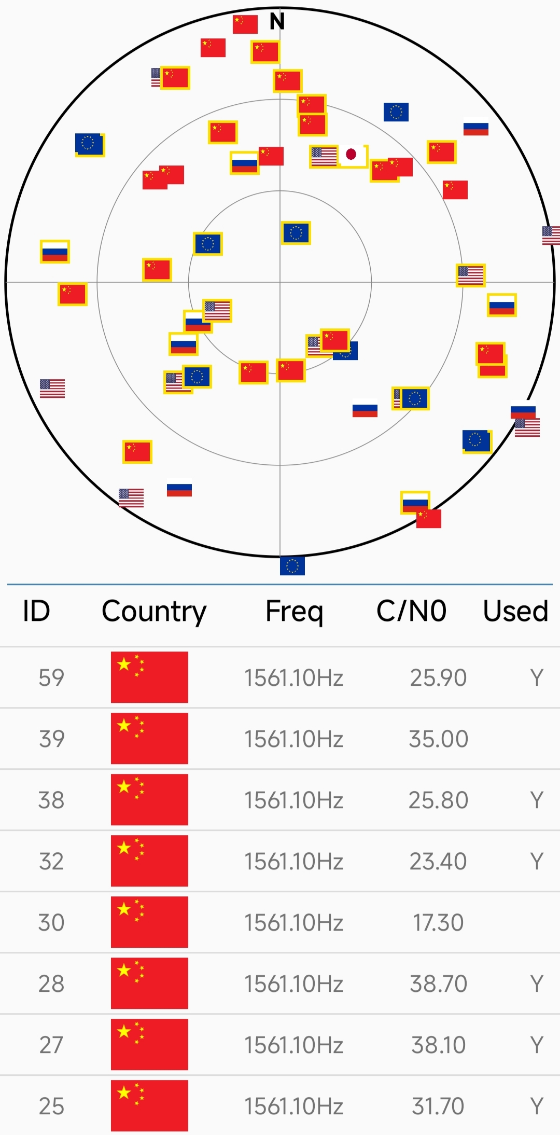
Fingerprint Construction
Using outdoor trajectories to construct fingerprint set
  Each trajectory includes Wi-Fi lists and GNSS locations
Wi-Fi list
GNSS location
Notes:
Regarding fingerprint construction, we construct fingerprints using outdoor trajectories (close to buildings). Each trajectory consists of scanned Wi-Fi lists and corresponding GNSS locations.
关于指纹库构建，我们使用（靠近建筑物的）用户轨迹构建室外指纹。每条轨迹包括Wi-Fi列表以及相关的GNSS位置。

Slide 10
Abnormal Identification
Three typical abnormal APs
  Mobile APs
    such as smartphone hotspots, car play, etc.
  Migrant APs
    a store or a company permanently move from one location to another place
  Cloned APs
    different APs share the same BSSID and they simultaneously stay active
Mobile APs
Migrant APs
Cloned APs
Notes:
Regarding anomaly detection, we first identified three typical types of abnormal APs, whose fingerprints likely cause significant reduction in positioning accuracy.
The first type is mobile APs, such as mobile hotspots, carplay, and so on.
The second type is moved APs. AP devices that are relocated to new locations along with the relocation of businesses or companies.
The third type is cloned APs, where two or more devices in different areas share the same BSSID.
The fingerprints of these abnormal APs lead to reduced positioning accuracy and severe positioning drift.
Therefore, timely detection of such abnormal APs can improve the positioning accuracy and robustness of our system.
关于异常识别，我们首先发现了三类典型异常AP。所谓异常AP，其指纹容易造成极大的定位误差干扰。
第一类，移动AP，比如手机热点、车载Wi-Fi等。
第二类，搬家AP，AP设备岁商家或公司搬迁到新地点。
第三类，克隆AP，同时存在两个或多个不同区域的设备具备相同BSSID（Wi-Fi Mac地址）。
这些异常AP指纹都会导致定位精度下降、定位漂移巨大。
因此，及时挖掘此类异常AP能够提升系统定位精度与鲁棒性。

Slide 11
Abnormal Identification
Multi-autoencoder based abnormal detection
  Extracting features from fingerprints of each AP
  Unsupervised learning with multi-autoencoder network
Notes:
To identify abnormal APs, we propose an anomaly detection method based on multi-autoencoder network.
First, we extract three types of features from AP fingerprints: coverage area, scanning amount, and service time.
Next, we construct a multi-autoencoder model to reconstruct these features from three perspectives: geospatial view, request view, and temporal view. The similarity between the original and reconstructed features is used as an "AP score" to identify abnormal APs.
为了识别异常AP，我们提出了基于多层自编码器的异常检测方法。首先，我们从AP指纹中提取三类特征：覆盖范围、扫描热度、服务时间。然后，我们搭建了多层自编码器网络，从地理空间、用户请求与服务时间三个视角重构特征，原始特征与重构特征的相似度（L2）作为AP得分以识别异常AP。（得分越高异常AP的概率越大）
后续还有异常AP的分类，在PPT中就不作介绍了！（感觉时间上也来不及）

Slide 12
Fingerprint Augmentation
“Unfamiliar APs” (non-fingerprint APs)
  APs with none fingerprints
“Co-occurrent APs”
  Appear in the same scanned list
Co-occurrent APs
Notes:
In terms of fingerprint augmentation, I will first introduce unfamiliar APs and co-occurrent APs.
Unfamiliar APs are APs with none fingerprints. Co-occurrent APs represent they appear in the same scanned list as show in the right figure.
关于指纹增强，我们首先介绍“无指纹”AP——没有指纹的AP。[废话了…]
“共现”AP——AP出现在同一个扫描列表中。
对于无指纹AP，指纹增强方法分为两步。第一，无指纹AP的共现AP位置估算。我们提出了最大似然估计算法，使用AP指纹结合信号传播的对数距离路径损耗（LDPL）模型与最小二乘法，估算共现AP位置，该位置将作为无指纹AP的增强指纹的位置信息。第二，我们将多次出现的共现AP信息聚合，比如信强和时间等信息，结合位置信息，实现无指纹AP的增强指纹的构建。
指纹增强不仅适用于无指纹AP，对于指纹稀疏的AP同样适用。
指纹增强可以解决无指纹AP带来的定位失效以及稀疏指纹AP带来的定位精度下降难题。

Slide 13
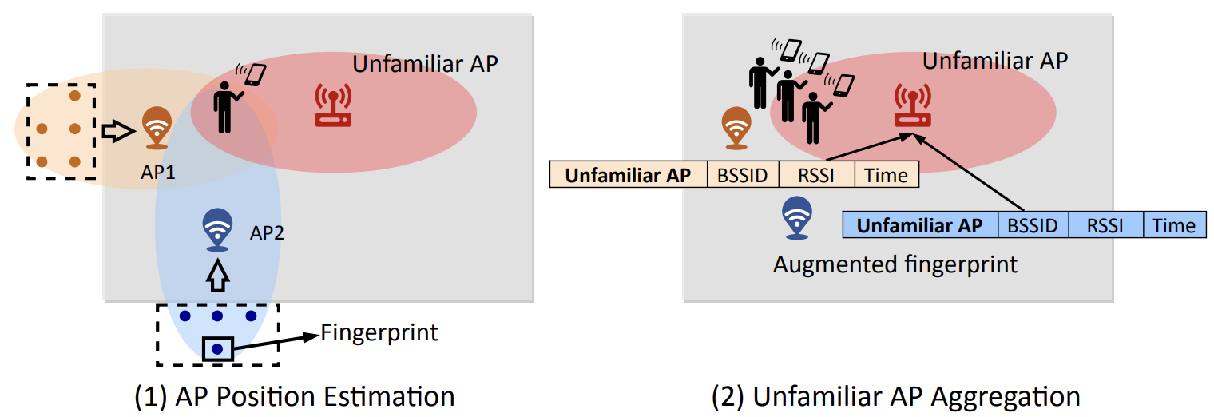
Fingerprint Augmentation
AP position estimation
  Proposing Maximum Likelihood Estimation (MLE) method with least-squares (LS)
Unfamiliar AP aggregation
  RSSI, Scanning amount, Service time
Notes:
For unfamiliar APs, the fingerprint augmentation consists of two steps.
First, we estimate the location of co-occurring APs for unfamiliar APs. We propose a maximum likelihood estimation algorithm that uses fingerprints, combined with the Log-Distance Path Loss (LDPL) and the least squares method, to estimate the location of co-occurring APs. This estimated location serves as the position of enhanced fingerprint for the unfamiliar AP.
Second, we aggregate multiple co-occurring APs information, including signal strength and timestamp, and integrate these with the estimated positions to construct enhanced fingerprints for unfamiliar APs.
Fingerprint augmentation is applicable not only to unfamiliar APs but also to APs with sparse fingerprints.
In summary, fingerprint augmentation addresses two key issues: unavailable positioning caused by unfamiliar APs and reduced positioning accuracy caused by APs with sparse fingerprints.
关于指纹增强，我们首先介绍“无指纹”AP——没有指纹的AP。[废话了…]
对于无指纹AP，指纹增强方法分为两步。第一，无指纹AP的共现AP位置估算。我们提出了最大似然估计算法，使用AP指纹结合信号传播的对数距离路径损耗（LDPL）模型与最小二乘法，估算共现AP位置，该位置将作为无指纹AP的增强指纹的位置信息。第二，我们将多次出现的共现AP信息聚合，比如信强和时间等信息，结合位置信息，实现无指纹AP的增强指纹的构建。
指纹增强不仅适用于无指纹AP，对于指纹稀疏的AP同样适用。
指纹增强可以解决无指纹AP带来的定位失效以及稀疏指纹AP带来的定位精度下降难题。

Slide 14
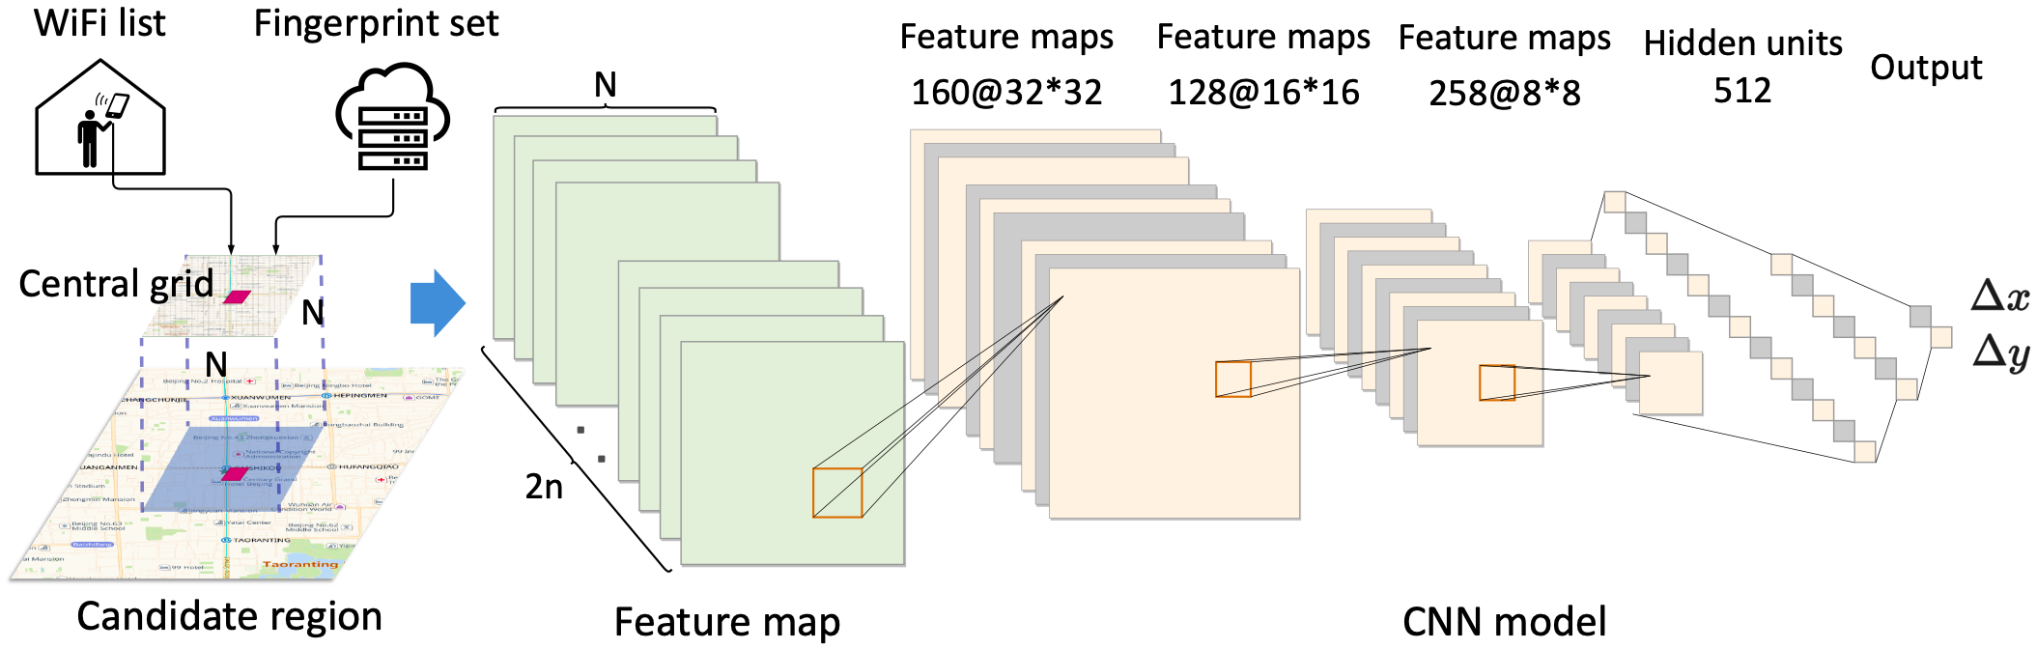
Localization
Candidate region production
  Utilize scanned Wi-Fi list to estimate candidate region based on crowdsourced fingerprint set
Feature map generation
  Calculate two types of features, i.e., signature similarity and scanning amount
CNN-based localization
Notes:
Regarding localization, it consist of three steps.
First, we utilize scanned Wi-Fi list to estimate candidate region based on crowdsourced fingerprint database.
Second, for each AP in candidate region, we calculate two types of features, including signature similarity and scanning amount, to generate feature maps.
Third, we stack these feature maps and input them into a CNN model to estimate users’ location.
关于定位，共分为三步。首先，候选区域生成。我们使用室内用户扫描的Wi-Fi列表结合指纹库，生成候选区域。其次，特征图生成。在候选区域内，对于任一扫描的AP，我们构建特征相似度与扫描热度特征图。最后，我们将特征图拼接输入CNN估算用户位置。

Slide 15
Evaluation
Experiment Overview
  Can our system perform indoor positioning using only fingerprints collected outdoors?
  Does abnormal detection enhance positioning accuracy?
  Can fingerprint augmentation improve positioning accuracy?
  Is our system scalable across different mobile models?
  How does our system compare with existing indoor positioning methods?
Notes:
To evaluate our system, we conduct extensive experiments. We focus on answering the following questions.
Can our system perform indoor positioning using only fingerprints collected outdoors?
Does abnormal detection enhance positioning accuracy?
Can fingerprint augmentation improve positioning accuracy?
Is our system scalable across different mobile models?
How does our system compare with existing indoor positioning methods?
为了全面地评估方法性能，我们进行了大量实验。实验主要回答如下五个问题：
1、我们的方法能否仅利用在户外采集的指纹来进行室内定位？
2、异常检测与分类是否能提高定位精度？
3、指纹增强是否能提升定位精度？
4、我们的系统能否适用于不同类型的移动设备？
5、我们的系统与现有的室内定位方法相比如何？
为此，我们准备了两部分评估数据。一是典型场景（教学楼、商场）的定位精度；二是大规模众包场景的业务指标（上车点误差）性能。
滴滴网约车平台用户发起打车请求后的上车点是根据用户位置推荐的，上车点误差表示真实上车点与推荐上车点间的距离。上车点误差越小，定位精度越高。

Slide 16
Evaluation
Experimental Setup
  Dedicated experiments with positioning accuracy
    a college building & a shopping mall
  Large-scale experiments with pickup position error
    ~122m ride-hailing orders across 13m devices from DiDi ride-hailing platform
    pickup position error
      the distance between the recommended pickup location and the actual pickup location
Notes:
To this end, we prepared two sets of evaluation data.
First, to evaluate positioning accuracy, we conducted dedicated experiments in typical scenarios (a college building and a shopping mall).
Second, we perform large-scale experiments based on DiDi ride-hailing platform with industrial metrics called “pickup position error”.
The pickup position recommended to users after passengers request an order is determined based on their location. Pickup position error refers to the distance between the actual and recommended pickup positions.
为了全面地评估方法性能，我们进行了大量实验。实验主要回答如下五个问题：
1、我们的方法能否仅利用在户外采集的指纹来进行室内定位？
2、异常检测与分类是否能提高定位精度？
3、指纹增强是否能提升定位精度？
4、我们的系统能否适用于不同类型的移动设备？
5、我们的系统与现有的室内定位方法相比如何？
为此，我们准备了两部分评估数据。一是典型场景（教学楼、商场）的定位精度；二是大规模众包场景的业务指标（上车点误差）性能。
滴滴网约车平台用户发起打车请求后的上车点是根据用户位置推荐的，上车点误差表示真实上车点与推荐上车点间的距离。上车点误差越小，定位精度越高。

Slide 17
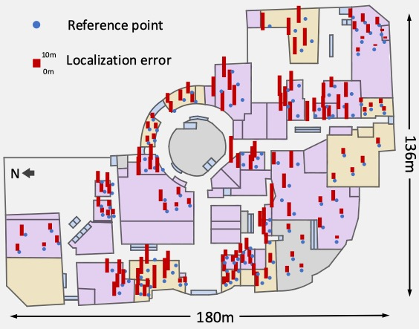
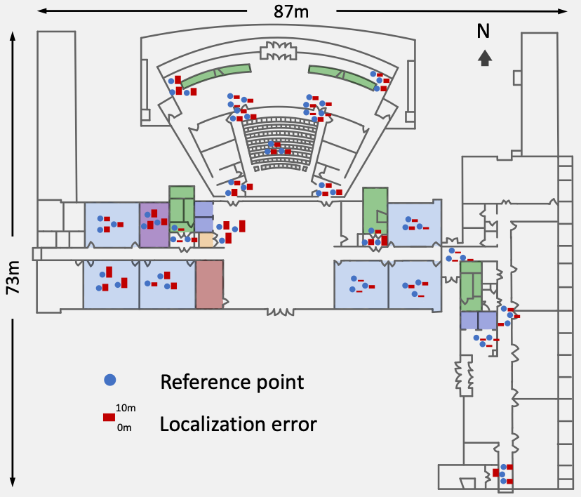
Evaluation
Localization accuracy
  College building (left) and shopping mall (right)
  Median localization error of 9~14m near roads
Notes:
We conducted tests separately in a college building and a shopping mall.
The results showed that in buildings near the roads, the median positioning error was between 9~14 meters, which met the daily positioning requirements.
我们分别在教学楼和商场进行了测试，结果表明在建筑物内靠近道路的区域，本方法定位误差中值在9～14米，满足日常定位需求。

Slide 18
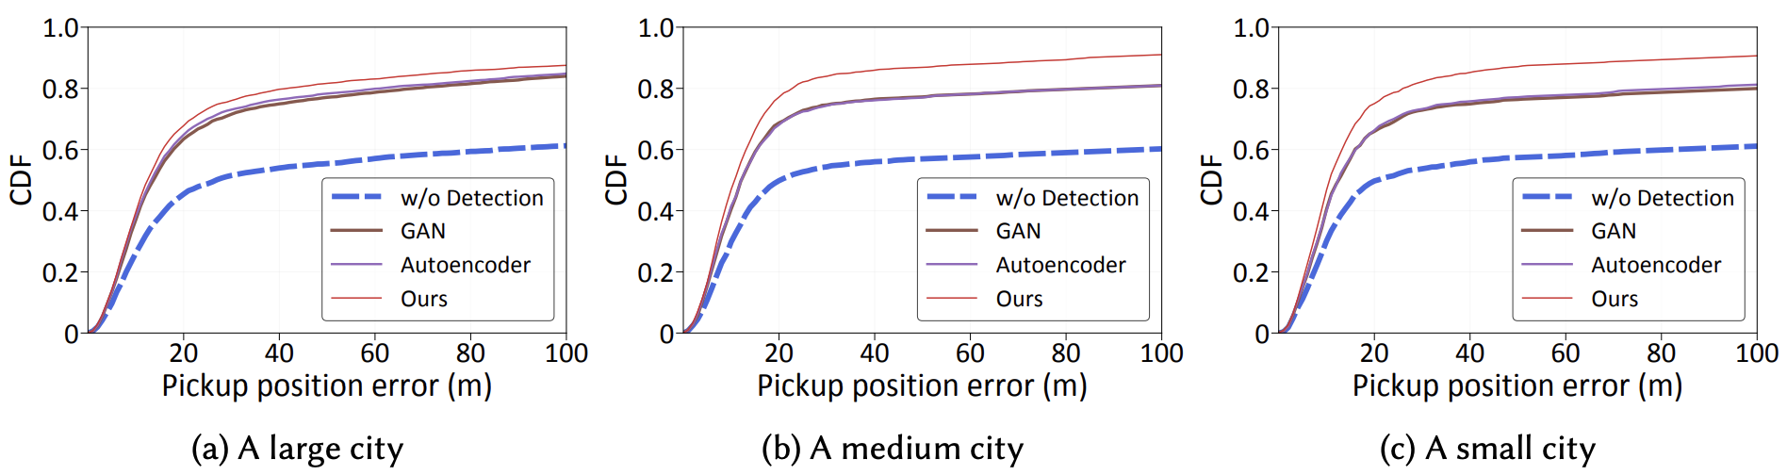
Evaluation
Performance of abnormal identification
Notes:
We evaluated the performance of anomaly detection on large-scale datasets, and the results show that our method effectively improved the positioning accuracy.
我们在大规模数据集上评估了异常识别的性能，结果表明我们方法有效提升了定位精度。

Slide 19
Evaluation
Performance of abnormal identification
  Performance of abnormal identification
Notes:
We evaluated the performance of anomaly detection and classification on large-scale datasets, and the results show that our method effectively improved the positioning accuracy.
我们在大规模数据集上评估了异常识别与分类的性能，结果表明我们方法有效提升了定位精度。

Slide 20
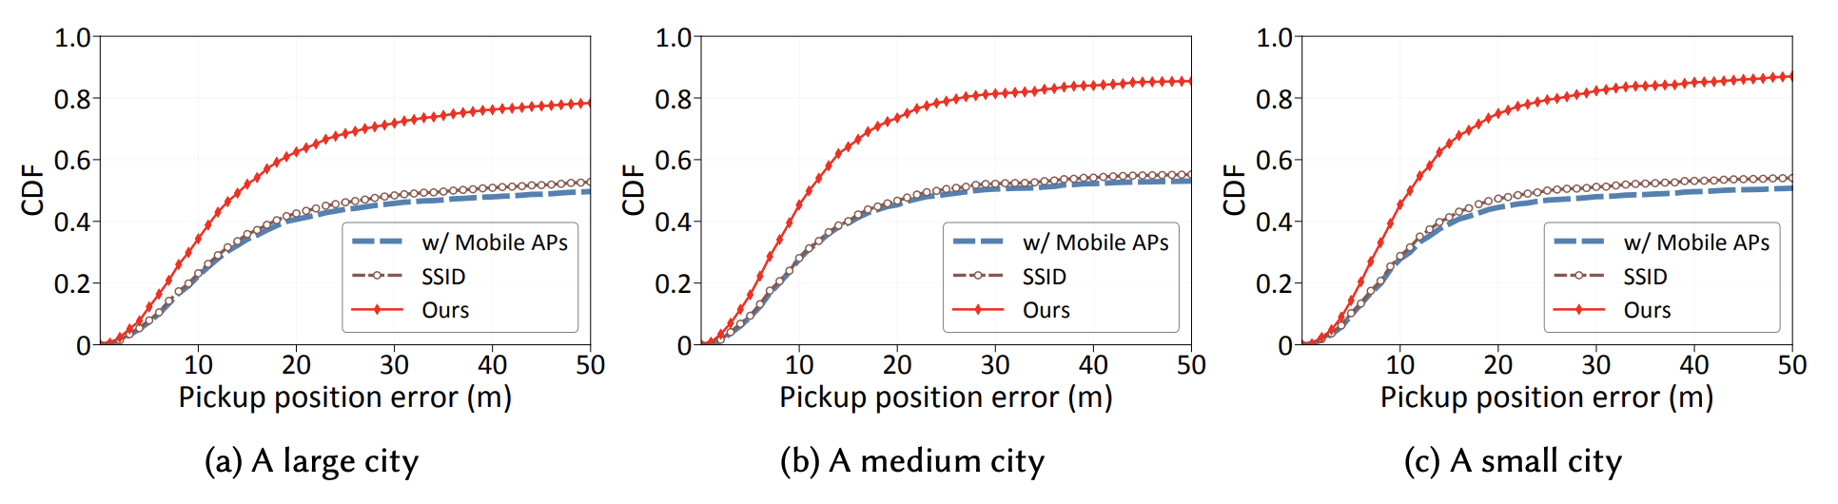
Evaluation
Performance of abnormal identification and classification
  Performance of abnormal identification
  Performance of mobile AP classification
Notes:
We evaluated the performance of anomaly detection and classification on large-scale datasets, and the results show that our method effectively improved the positioning accuracy.
我们在大规模数据集上评估了异常识别与分类的性能，结果表明我们方法有效提升了定位精度。

Slide 21
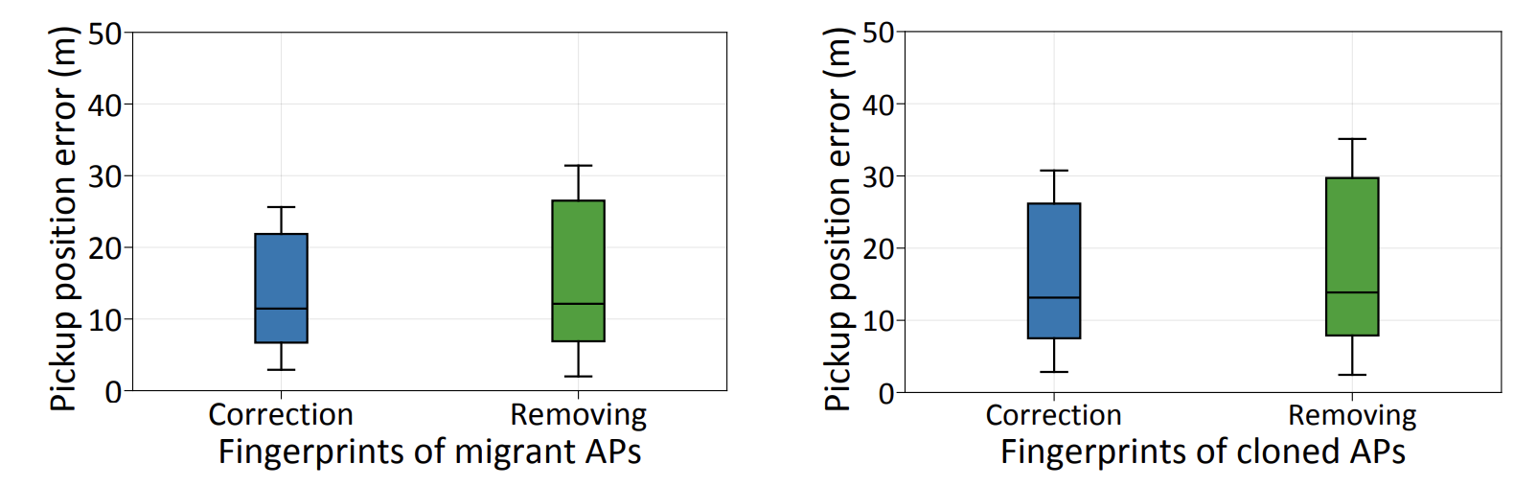
Evaluation
Performance of abnormal identification and classification
  Performance of abnormal identification
  Performance of mobile AP classification
  Performance of migrant (left) and cloned (right) AP correction
Notes:
We evaluated the performance of anomaly detection and classification on large-scale datasets, and the results show that our method effectively improved the positioning accuracy.
我们在大规模数据集上评估了异常识别与分类的性能，结果表明我们方法有效提升了定位精度。

Slide 22
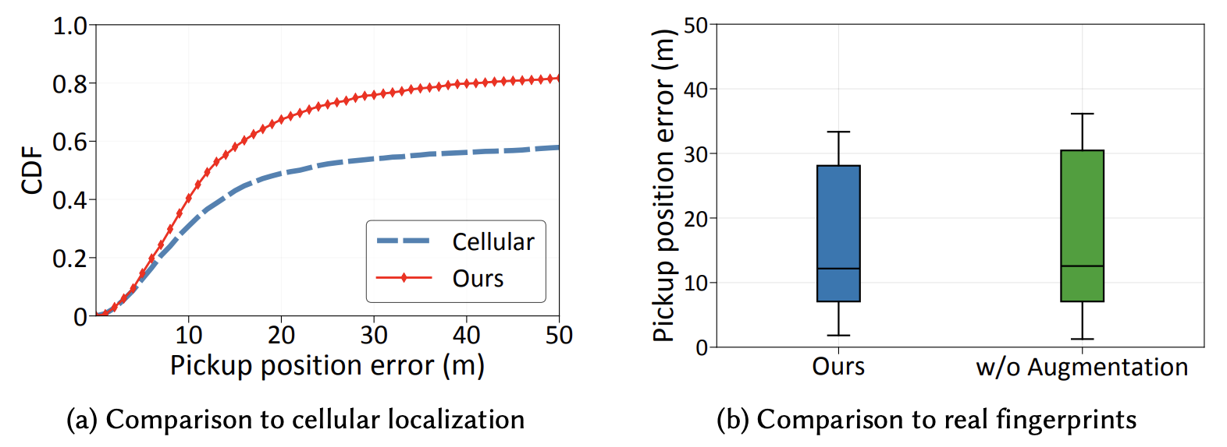
Evaluation
Performance of augmentation
  Performance of augmentation for non-fingerprint APs
Notes:
Additionally, we compared the positioning accuracy before and after fingerprint augmentation.
The results show that the fingerprint augmentation was effective in improving the positioning accuracy and usability for both unfamiliar/non-fingerprint APs and sparse fingerprint APs.
此外，我们对比了指纹增强前后的定位效果，结果表明针对无指纹AP与稀疏指纹AP的指纹增强有效提升了定位精度与可用性。
本文中，unfamiliar和non-fingerprint表达的含义一样！

Slide 23
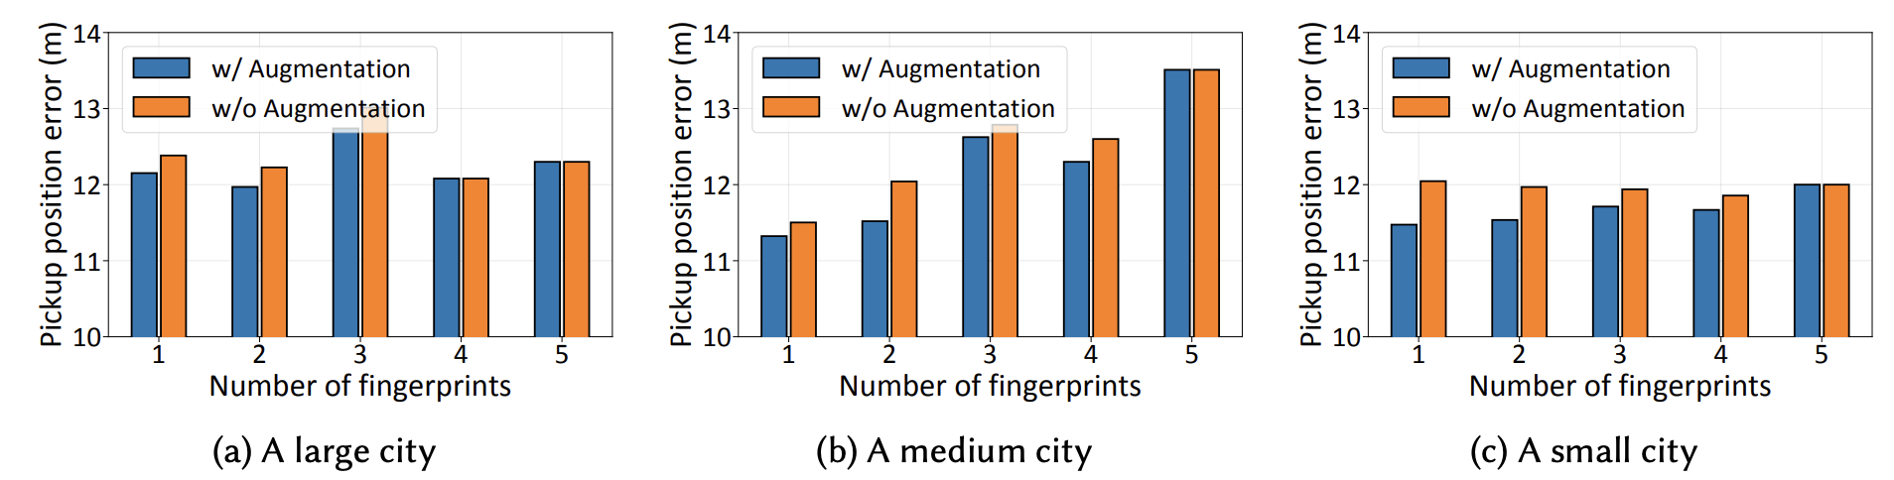
Evaluation
Performance of augmentation
  Performance of augmentation for non-fingerprint APs
  Performance of augmentation for sparse APs
Notes:
Additionally, we compared the positioning accuracy before and after fingerprint augmentation.
The results show that the fingerprint augmentation was effective in improving the positioning accuracy and usability for both unfamiliar APs and sparse APs.
此外，我们对比了指纹增强前后的定位效果，结果表明针对无指纹AP与稀疏指纹AP的指纹增强有效提升了定位精度与可用性。

Slide 24
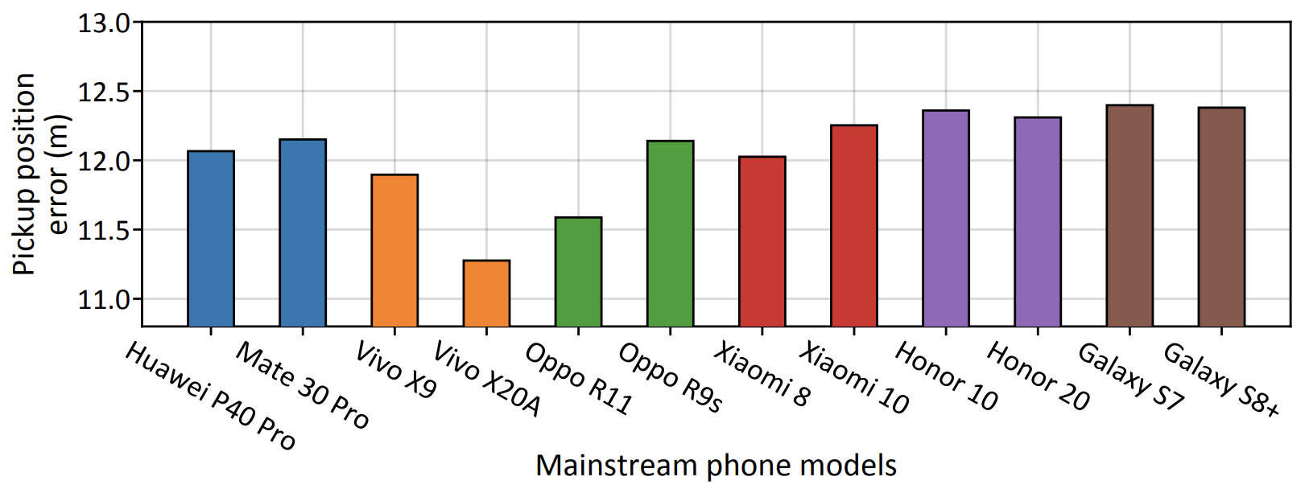
Evaluation
Performance across mainstream phone models
Comparison with existing efforts
  The median pickup position error for our system was 10.44m, which is 4.35m lower than Lab2Wild[2] (Tencent Wi-Fi localization system)
[2] Experience: Pushing indoor localization from laboratory to the wild
Notes:
Finally, we evaluated the positioning performance of the method across 12 mainstream phone models.
The results show that our method achieves good compatibility across various phone models.
In addition, when compared with existing methods, pickup position error was reduced by 29.4%.
最后，我们评估了方法在12种不同主流手机型号的定位性能，结果表明本方法在不同智能手机型号上具有良好的兼容性。
此外，我们与现有方法（腾讯2022年mobicom WiFi室内定位）对比，上车点误差降低了29.4%。

Slide 25
Conclusion
We proposed a new novel Wi-Fi fingerprint-based localization scheme
  Only leveraging crowdsourced outdoor fingerprints to locate indoor users
We presented three key technologies
  Designing a multi-autoencoder model to identify abnormal APs
  Constructing augmented fingerprints via co-occurrent APs
  CNN-based indoor localization
Future work
  Utilizing transfer learning and user feedback to further improve localization accuracy
Notes:
In conclusion, we proposed a new novel Wi-Fi fingerprint-based localization scheme, only leveraging crowdsourced outdoor fingerprints to locate indoor users
We presented three key technologies, including designing a multi-autoencoder model to identify abnormal APs, constructing augmented fingerprints via co-occurrent APs, and CNN-based indoor localization.
In the future, we will focus on utilizing transfer learning and user feedback to further improve localization accuracy.
综上所述，我们提出了一种新颖的Wi-Fi指纹定位方法，仅使用室外众包指纹定位室内用户。我们展示三大关键技术：基于多层自编码器的异常AP识别、基于共现关系的指纹增强、基于CNN的室内定位方法。
最后，在未来我们将使用迁移学习与用户反馈进一步提升定位精度。

Slide 26
Thanks!
Q&A
Notes:
Thanks!
Any questions!

